Slide 1


News Text Classification
Using Various Machine Learning Models
“A MultiClass label Problem”
Aman(10),Sagar(49),Satyam(51)

Slide 2
Dataset
For this research, we used the BBC world news dataset. The data consists of a total of 2225 text documents from the BBC world news website corresponding to the stories covered in 2004-2005. The total size of the data is around 5 MB.
The data is pre-classified into 5 different class labels. These class labels are Business, Sport, Tech, Entertainment, and Politics. It contains 503 text documents from the business category, 504 text documents from the sports category, 347 text documents from the tech category, 369 text documents from the entertainment category, and 403 articles from the politics category.
There are a total number of 456,542 words in all the documents while containing only 29,126 unique words. This means that on average every word appears average about 15 times throughout the whole corpus. The average document length is 205 words.

Slide 3
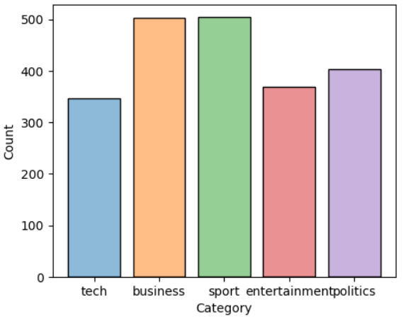
Visualization (contd.)
Class labels are Business, Sport, Tech, Entertainment, and Politics.
It contains 503 text documents from the business category, 504 text documents from the sports category, 347 text documents from the tech category, 369 text documents from the entertainment category, and 403 articles from the politics category.

Slide 4

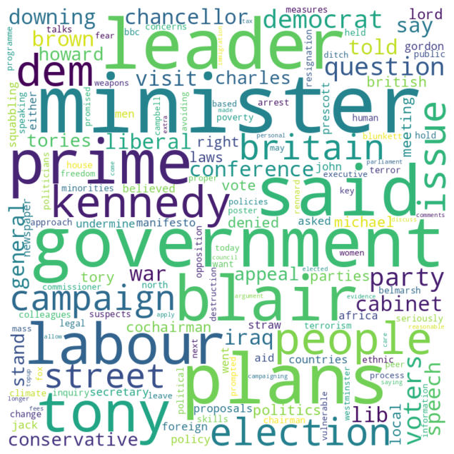
Visualization (contd.)
Tech
Politics

Slide 5


Visualization (contd.)
Business
Entertainment

Slide 6
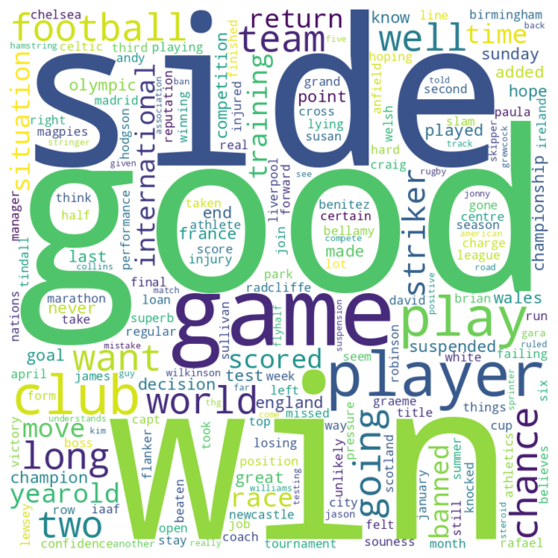
Visualization (contd.)
Sports

Slide 7
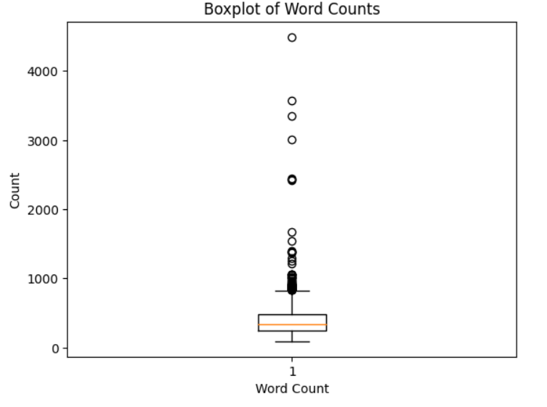
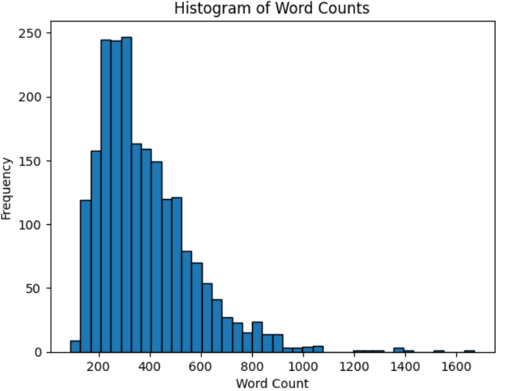
Visualization (contd.)
Boxplot - Helps to find outliers.
Histogram - Having words under 2000

Slide 8
Data Preprocessing
Text preprocessing involves eliminating noise such as punctuation, numbers, and irrelevant words (stop words) from the dataset.
The goal is to make the text more uniform and structured, thereby helping NLP models focus on meaningful information and improving their efficiency and effectiveness.
Python libraries like NumPy, pandas, and scikit-learn are commonly used to streamline these tasks, ensuring efficient data handling and analysis.

Slide 9
Data Preprocessing
01
Lowercasing
04
Stopwords Removal
Steps involved
02
Punctuation Removal
05
Omitting Short Words
03
Numbers Removal
06
Removal of Extra Spaces

Slide 10
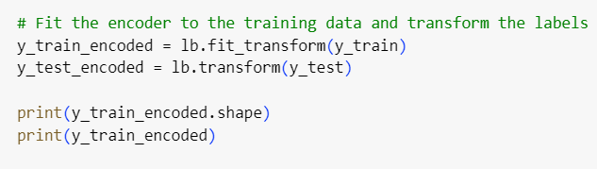
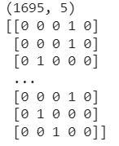
Label Encoding
Label encoding is a technique used to convert categorical labels into numerical format, typically integers. In label encoding, each unique category is assigned a unique integer value.

Slide 11
Feature Extraction
It is very important to represent the text in which machine can easily understand. Therefore, Vectorizer has been used which converts the sentence or text into an array or vector of numbers.
To transform the term into a representation of number which has meanining we use TF-IDF.
Term Frequency is used for normalizing the occurrence of each word with size of the data set.
Inverse Document Frequency is used for removing the words which do not contribute much for deciding the meaning of the sentence.
TF-IDF algorithm’s main focus is on the word that has the higher frequency in the text, and at the same time, it appears in the corpus in a smaller range. Then, this word has the strongest capability to distinguish different classes in the text.

Slide 12
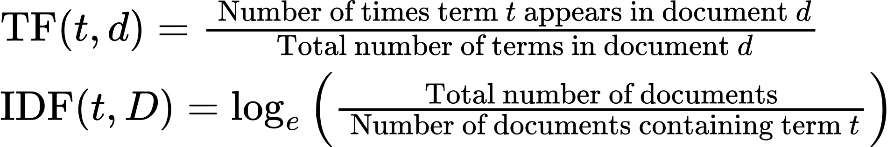
Feature Extraction
Formula :

Slide 13
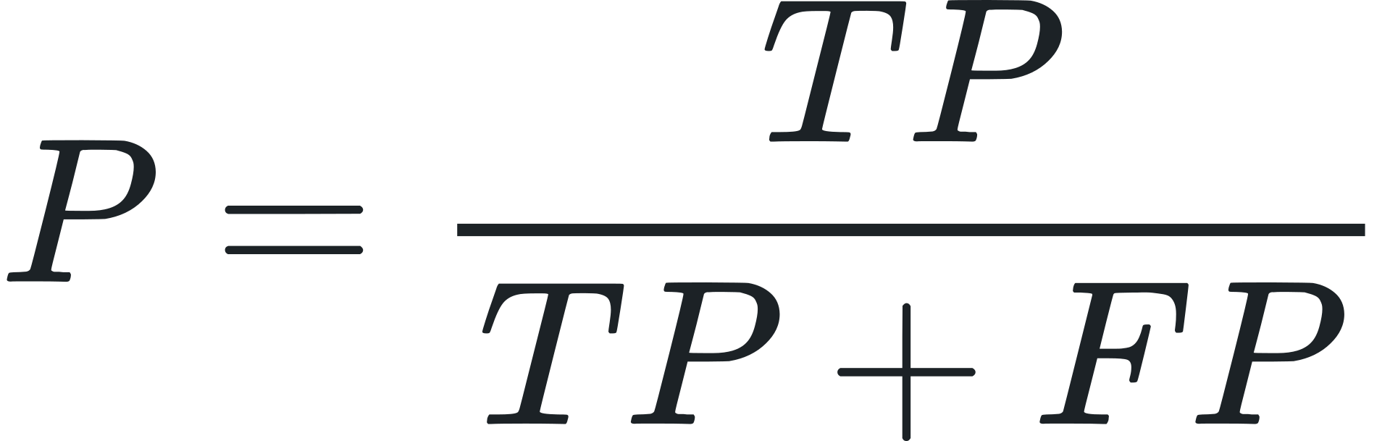
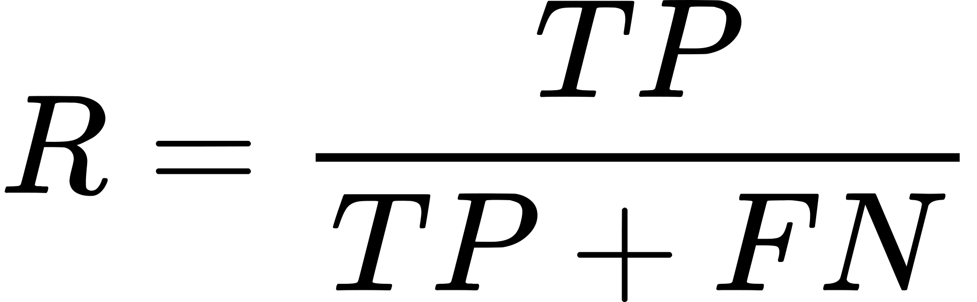
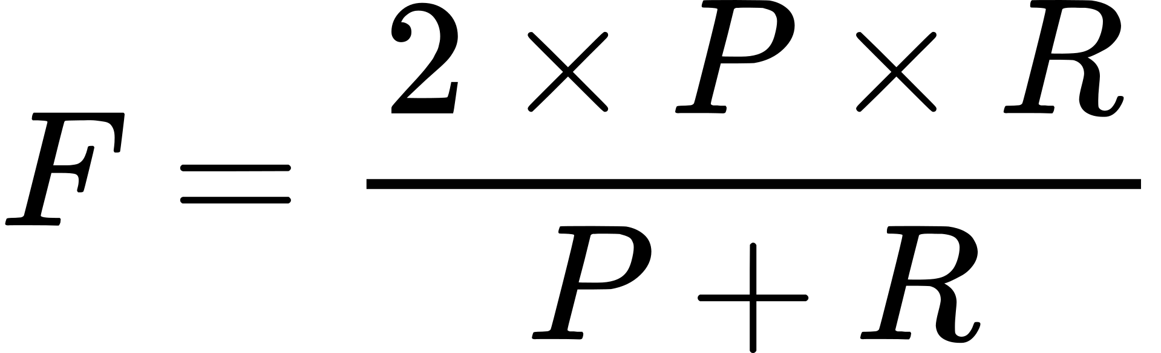
Model Selection and Training
Text classification mainly uses classifier to label the text of unknown category, so the most important part of classification is the selection of classification algorithm. At present, the most commonly used algorithm is machine learning, which lets the computer to train the classifier according to the training set.
For a dataset, whether a classification algorithm is appropriate for this data requires data metrics to evaluate the results, such as precision (P), recall (R), and F-measure (F).
where TP, FP and FN are the number of true positives, falsepositives and false negatives,

Slide 14
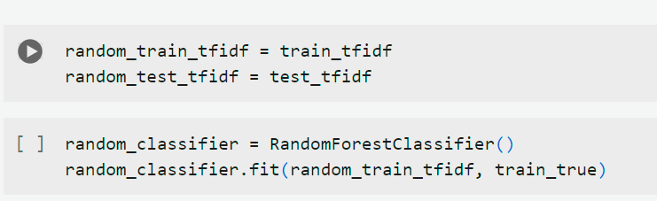
Random Forest
A random forest model is a extension of bagging technique that combines multiple decision trees to create a more accurate and robust prediction. It works by selecting random subsets of the data and features, also known as feature bagging, generates a random subset of features, which ensures low correlation among decision trees, and building a decision tree for each subset. Then, it aggregates the predictions of all the trees to produce the final output

Slide 15
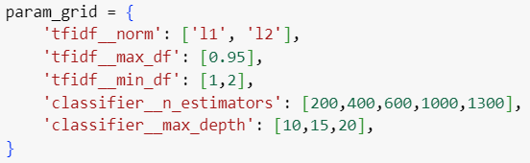
Grid Search for Random Forest
In our Random forest model we have assumed few hyperparameters and used grid search so that we know which parameters are best fit to our model
We have also used cross validation set during the grid search where the dataset will be split into 5 equal parts, where each part is used once as a validation while the other 4 parts are used for training.
And the best hyperparameters our grid search extracted for RF are -

Slide 16
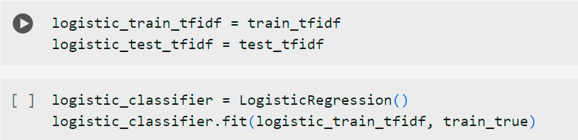
Logistic Regression
Logistic regression is a statistical method used for binary classification tasks. However, it can be extended to handle multiclass classification by employing techniques such as one-vs-all or multinomial logistic regression.In logistic regression, the probability that an instance belongs to a particular class is modeled using the logistic function (also known as the sigmoid function).For multiclass logistic regression, the probability of an instance belonging to each class is calculated, and the class with the highest probability is predicted.

Slide 17
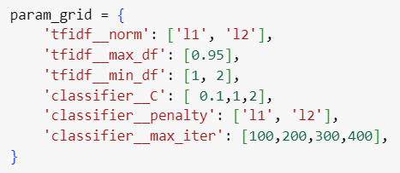
Grid Search for Logistic Regression
In our Logistic Regression model we have assumed few hyperparameters and used grid search. Also the hyperparameters for tf-idf are same as before.
Here we also used K - Cross Validation of 5.
And the best hyperparameters our grid search extracted for LR are -

Slide 18
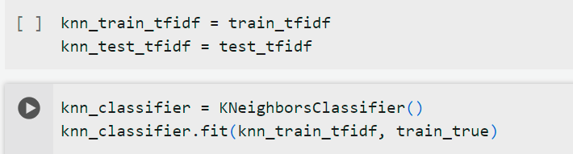
K-Nearest Neighbour (KNN)
k-Nearest Neighbors (kNN) is a simple and intuitive machine learning algorithm used for classification and regression tasks. In kNN classification, the class of a new data point is determined based on the class labels of its nearest neighbors in the feature space.
For multiclass classification with kNN, the class label of a new data point is often determined by a majority vote among its k nearest neighbors. Each neighborcontributes equally to the decision, and the class with the highest count among the neighbors is assigned to the new data point.

Slide 19
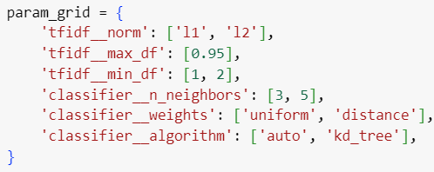
Grid Search for KNN
In our KNN model we have assumed few hyperparameters and used grid search. Also the hyperparameters for tf-idf are same as before.
Here we also used K - Cross Validation of 5.
And the best hyperparameters our grid search extracted for KNN are -

Slide 20
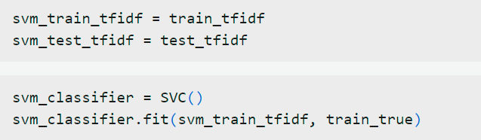
Support Vector Machine (SVM)
Support Vector Machine (SVM) is a powerful supervised learning algorithm used for both classification and regression tasks. In the context of classification, SVM aims to find the optimal hyperplane that best separates the data points into different classes, with the largest margin between the classes.
For binary classification, SVM finds the hyperplane by maximizing the margin between the nearest data points from each class, which are called support vectors.
For multiclass classification, SVM can be extended using techniques such as onevs-one or one-vs-all. In one-vs-one, SVM constructs a binary classifier for each pair of classes and then combines their outputs to make the final multiclass prediction.In one-vs-all, SVM trains a binary classifier for each class against the rest of the classes

Slide 21
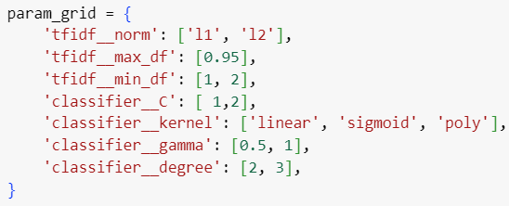
Grid Search for SVM
In our SVM model we have assumed few hyperparameters and used grid search. Also the hyperparameters for tf-idf are same as before.
Here we also used K - Cross Validation of 5.
And the best hyperparameters our grid search extracted for SVM are -

Slide 22
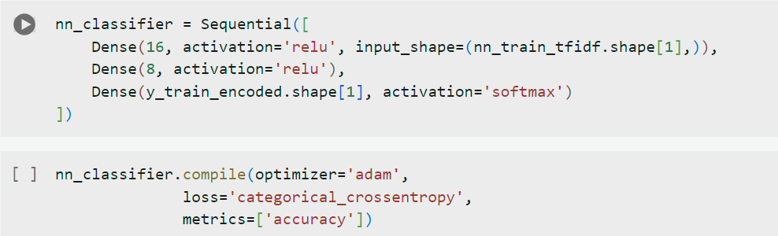
Neural Network
A neural network is a model inspired by the brain's structure. In multiclass classification, it categorizes inputs into multiple classes. It consists of layers: input, hidden, and output. The input layer receives data, hidden layers learn patterns, and the output layer predicts class probabilities. During training, it adjusts its weights to minimize prediction error. After training, it can classify new data into one of the classes it learned.

Slide 23
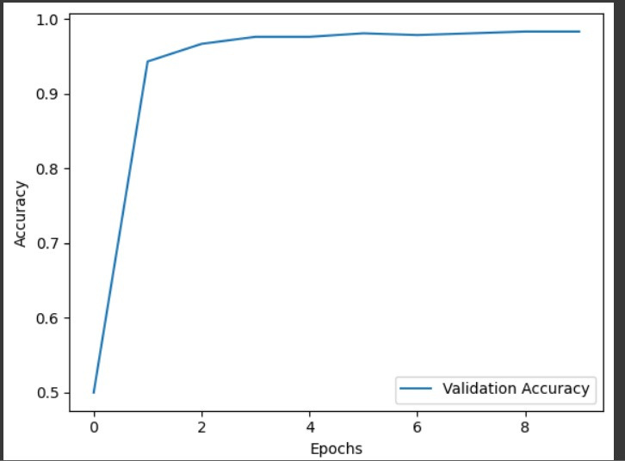
Neural Network Epochs

Slide 24
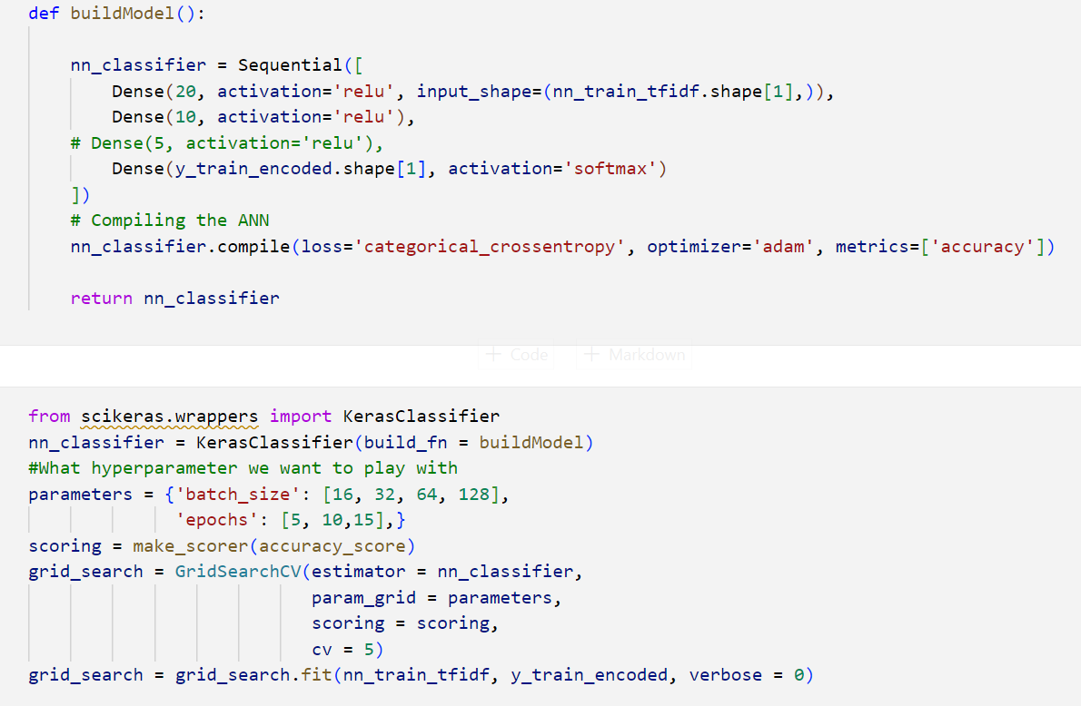
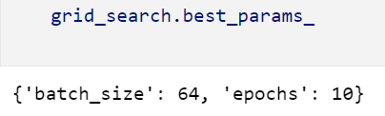
Grid Search (Neural Network)

Slide 25
Evaluation
We conduct a comparative study between models trained with default hyperparameters and those fine-tuned using grid search. The study aims to determine whether hyperparameter tuning significantly improves model performance across different algorithms. We systematically explore a range of hyperparameter combinations using grid search and evaluate the models using appropriate performance metric.

Slide 26
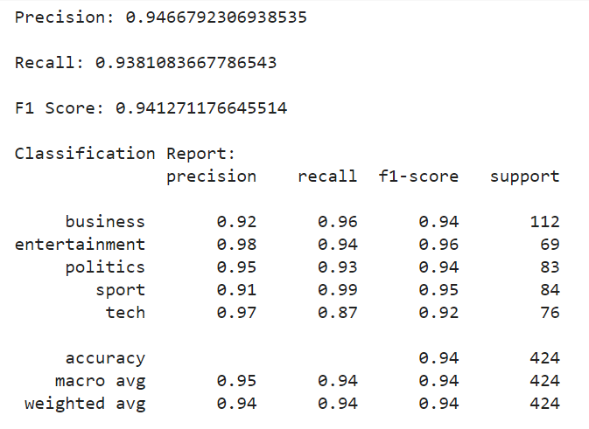
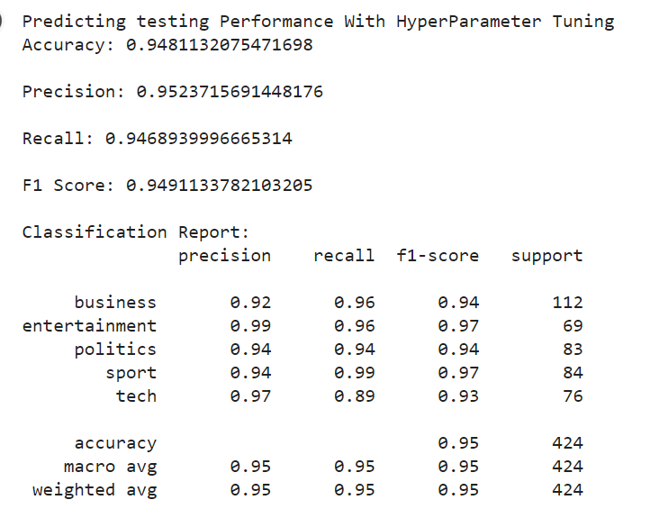
Random Forest
without tuning
with tuning

Slide 27
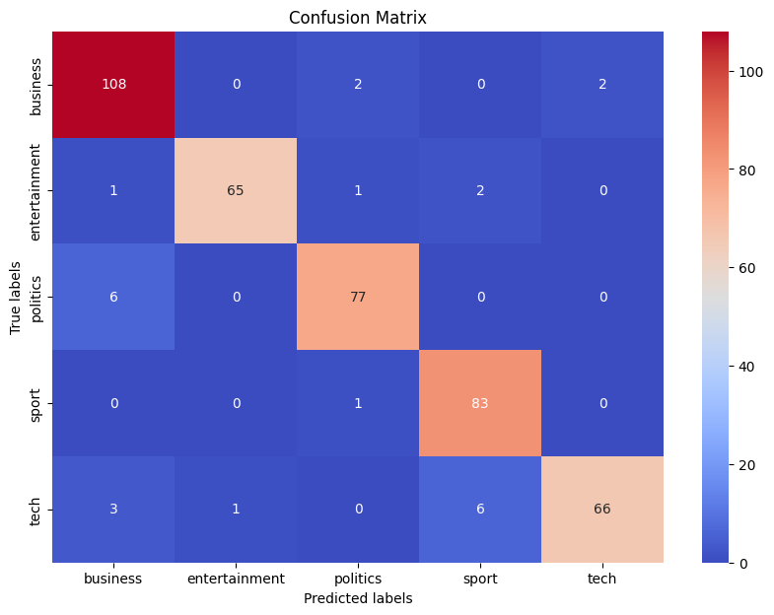
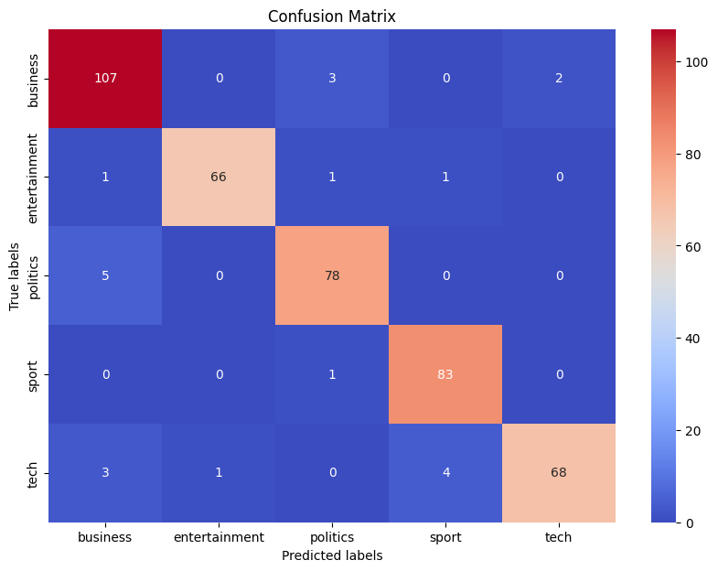
Random Forest
without tuning
with tuning

Slide 28
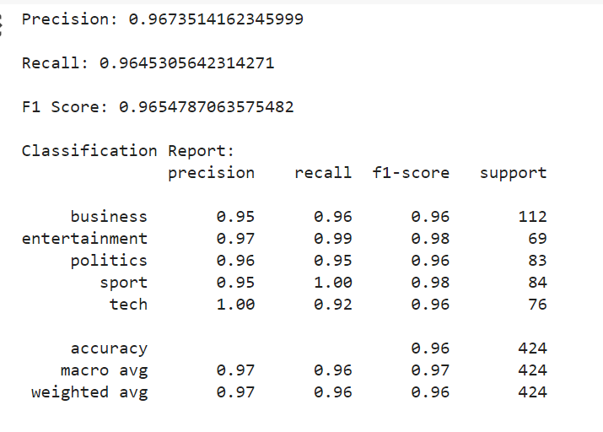
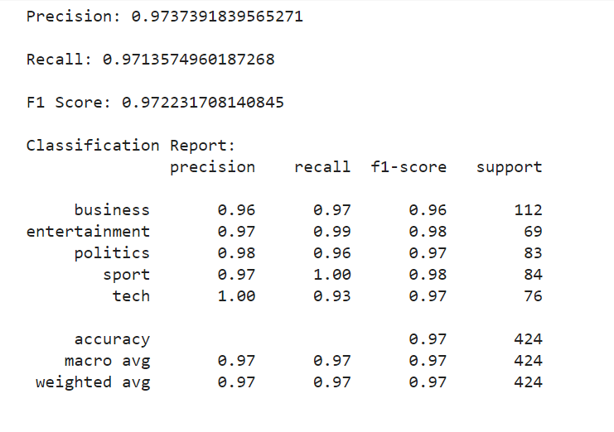
Logistic Regression
without tuning
with tuning

Slide 29

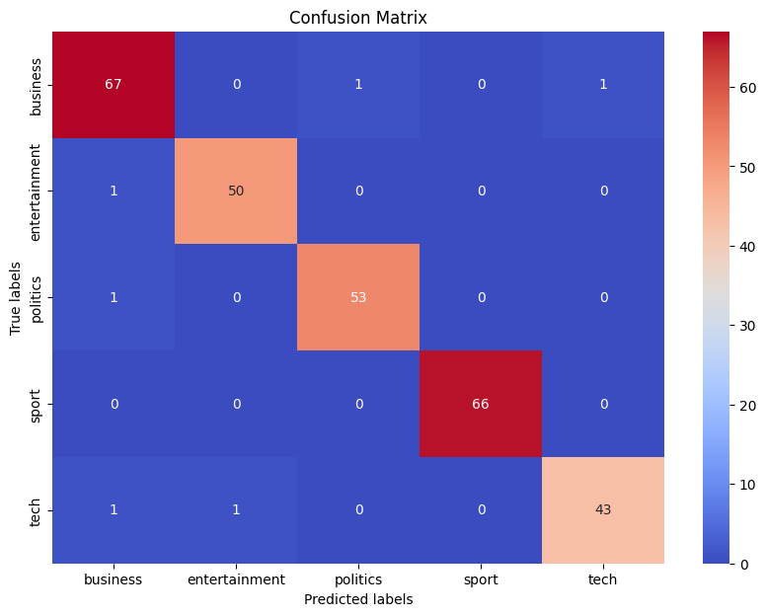
Logistic Regression
without tuning
with tuning

Slide 30
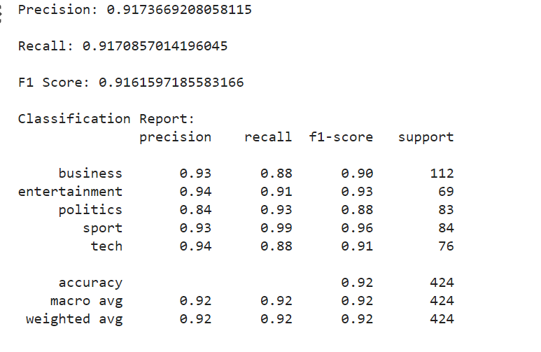
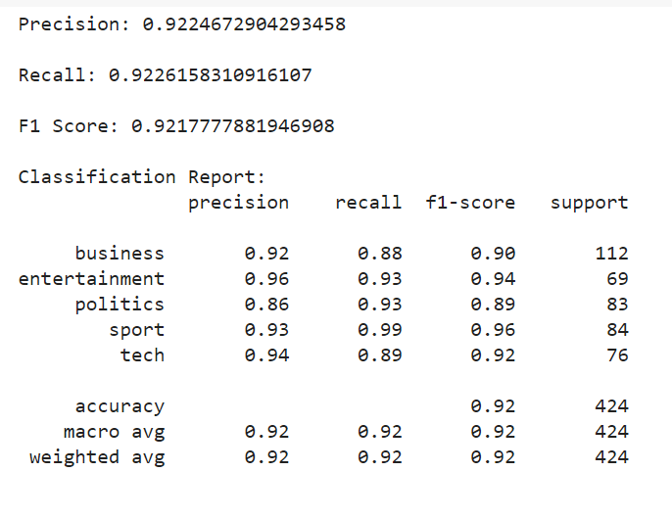
K-Nearest Neighbour (KNN)
without tuning
with tuning

Slide 31
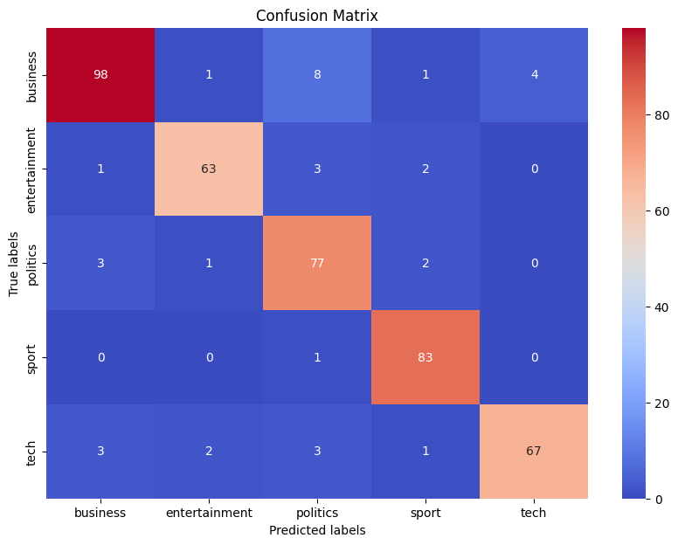

K-Nearest Neighbour (KNN)
without tuning
with tuning

Slide 32
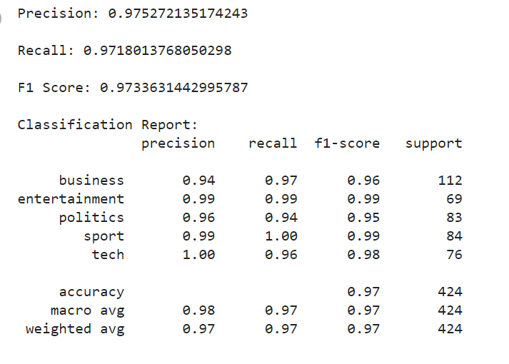
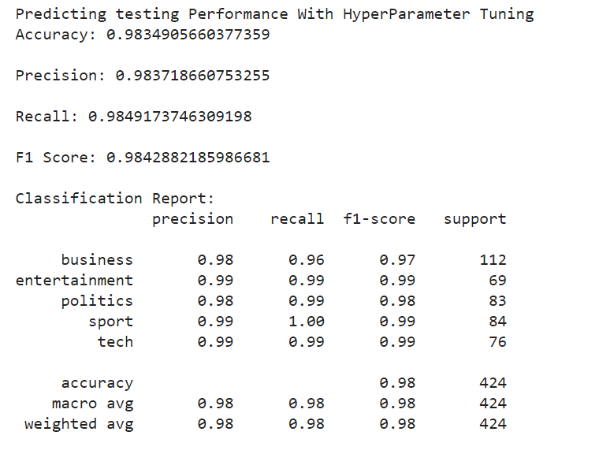
Support Vector Machine (SVM)
without tuning
with tuning

Slide 33

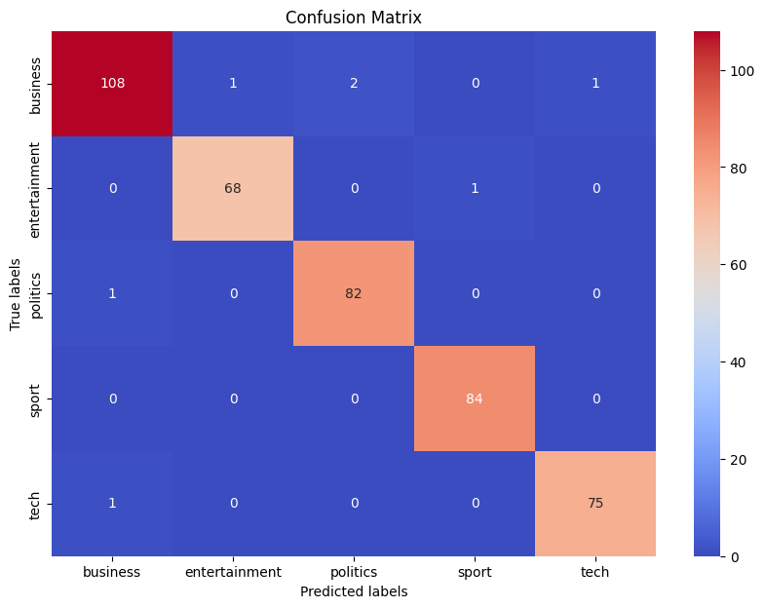
Support Vector Machine (SVM)
without tuning
with tuning

Slide 34
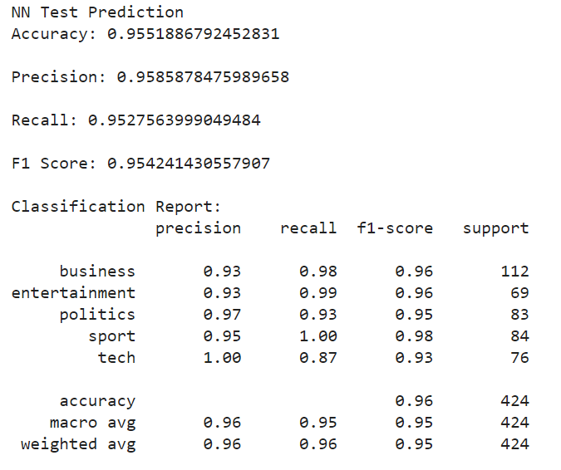
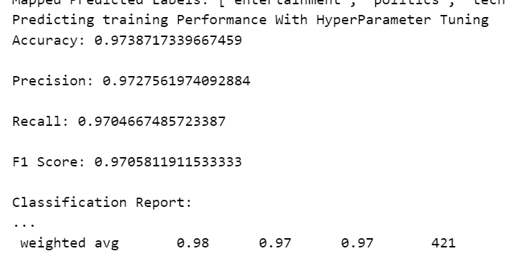
Neural Network
without tuning
with tuning

Slide 35

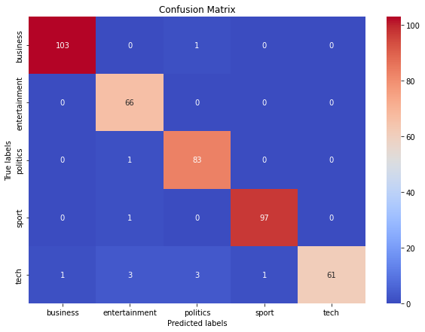
Neural Network
without tuning
with tuning

Slide 36
Result
Model | F1 Score | F1 Score
Model | Without Tuning | With Tuning
Random Forest | 0.9412 | 0.9491
Logistic Regression | 0.9654 | 0.9722
K-Nearest Neighbour | 0.9161 | 0.9217
Support Vector Machine | 0.9733 | 0.9842
Neural Network | 0.9542 | 0.9705

Slide 37
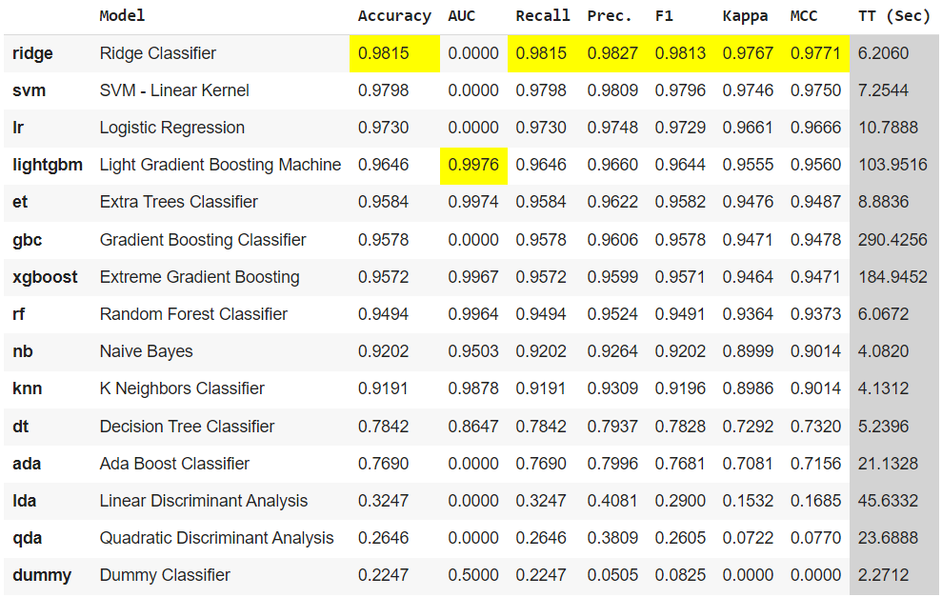
Pycaret
Model Comparision

Slide 38
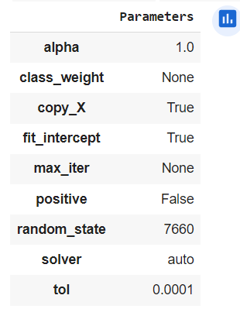
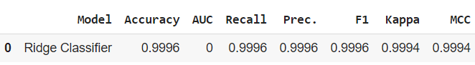
Pycaret - Ridge Classifier
Tuned Hyperparameters
Test Accuracy

Slide 39
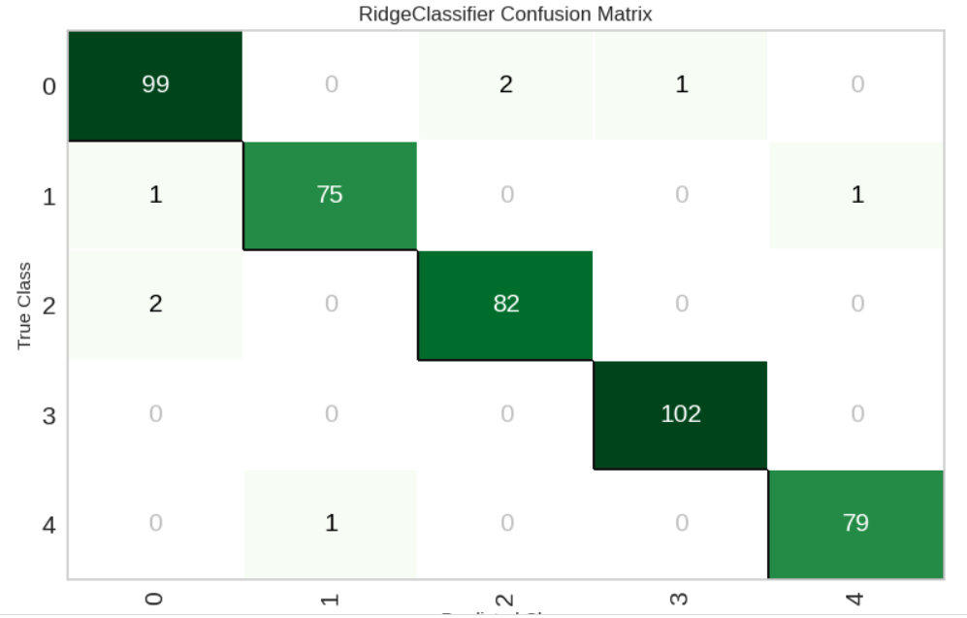
Pycaret - Ridge Classifier
Confusion Matrix

Slide 40
References
https://raw.githubusercontent.com/mdsohaib/BBC-News-Classification/master/bbc-text.csv
Shah, K., Patel, H., Sanghvi, D. et al. A Comparative Analysis of Logistic Regression, Random Forest and KNN Models for the Text Classification. Augment Hum Res 5, 12 (2020). https://doi.org/10.1007/s41133-020-00032-0
F. Miao, P. Zhang, L. Jin and H. Wu, "Chinese News Text Classification Based on Machine Learning Algorithm," 2018 10th International Conference on Intelligent Human-Machine Systems and Cybernetics (IHMSC), Hangzhou, China, 2018, pp. 48-51, doi: 10.1109/IHMSC.2018.10117.
Topic Classification of Online News Articles Using Optimized Machine Learning Models. Computers 2023, 12, 16. https://doi.org/10.3390/computers12010016
Text classification of BBC news articles and text summarization using text rank
https://machinelearningmastery.com/grid-search-hyperparameters-deep-learning-models-python-keras/

Slide 41
